Slide 1
Institutional Occupancies
Determine what differentiates this type of occupancy from others
Identify the key provisions that are different from the general chapters

Slide 2
Historic Fire
Ohio State Penitentiary

Slide 3
People
Types of people present
  Familiarity
  Abilities
Activities

Slide 4
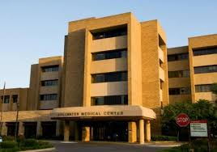
Occupancy Classifications- Institutional
I-2 Medical care
  24-hour care
  More than 5 people
  1-5 people: R-3
  Condition 1: Nursing and medical, no emergency, surgery, obstetrics, psychiatric/ detoxification
  Condition 2: Could provide all medical services
NFPA101 > 3 occupants

Slide 5
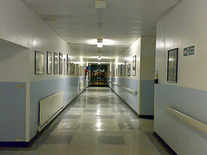
Evacuation Strategy
Minimize the need for evacuation
Consider occupants
Compartmentation
Horizontal exits
  Wide corridors
  Wide doors without mullion
Fewer restrictions on passing through spaces

Slide 6
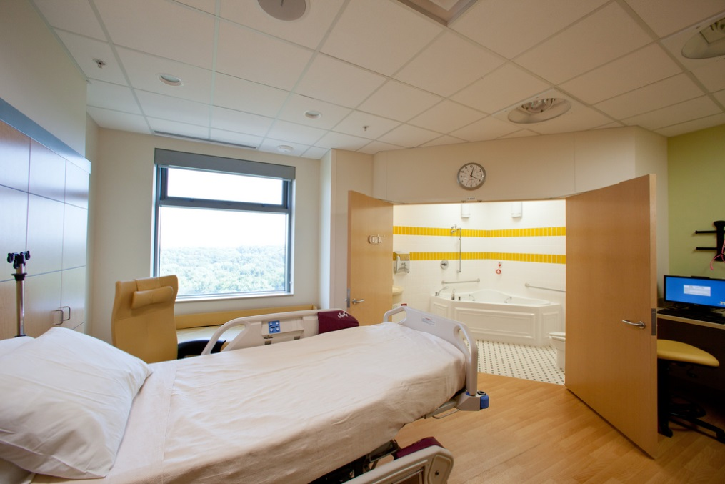
Suites
Hospitals generally divided into suites
Separated
Move towards less hazard
Directly to corridor or horizontal exit (100 ft)
Smoke detection
Limitations on decorations
Limitations on heaters

Slide 7
Related Issues
Life support equipment
  Emergency power requirements
Cooking
  Limitations on size, type, and control
Alcohol-based hand-rub dispensers
  Limitations on size and locations
HVAC
  Limitations on types and locations
Rehabilitation of nonsprinklered smoke compartments
Sprinklers without exceptions
Locking of doors

Slide 8
Drills and Fire Alarm
Must have emergency evacuation plan
Staff must be informed of duties
Quarterly drills for each shift
  Do not have to evacuate patients
Code phrases
Alarms can be visible only in critical care
Pull station at nurse’s station

Slide 9
Ambulatory Health Care
Outpatient care
  4 or more
Similar requirements
  More flexibility

Slide 10
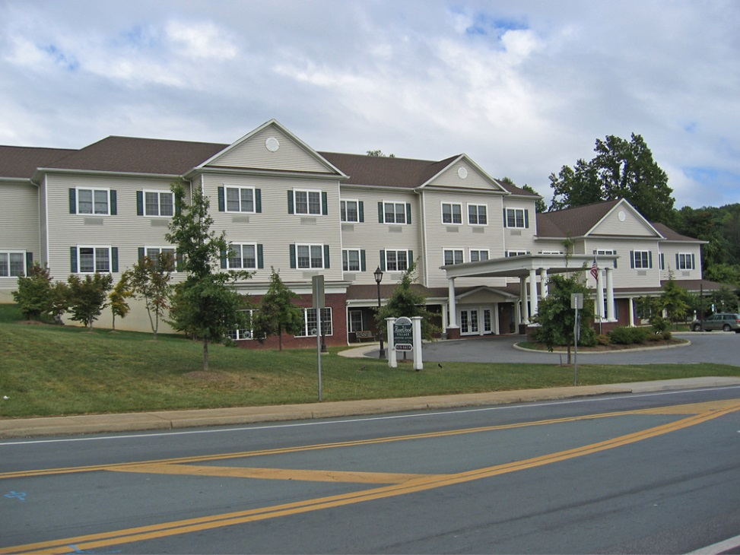
Occupancy Classifications- Institutional
I-1 Supervised living
  16+ people, excluding staff
  6-16 people: R-4
  1-5 people: R-3
  24-hour care
  Condition 1: Can self-evacuate
  Condition 2: Limited assistance

Slide 11
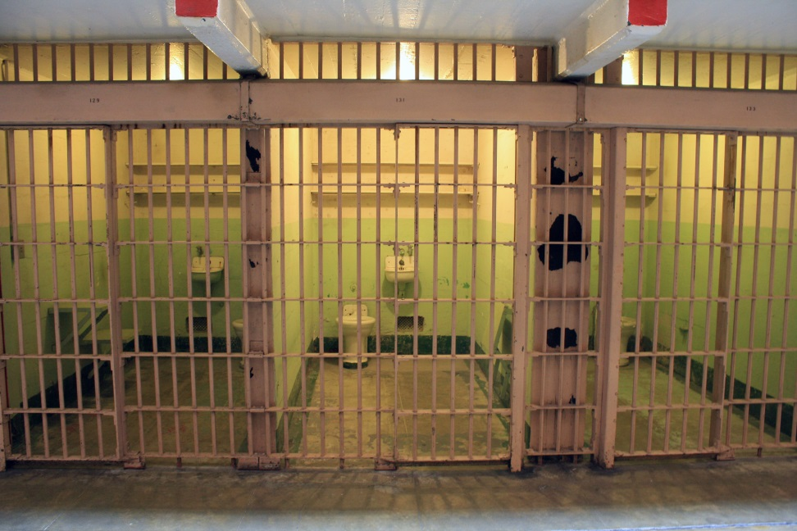
Occupancy Classifications- Institutional
I-3 Restrained
  More than 5 people
  Condition 1: Can freely evacuate to exterior
  Condition 2: Can freely move to another smoke compartment
  Condition 3: Can freely move within smoke compartment
  Condition 4: No free movement, remote-controlled release
  Condition 5: No free movement, manual release

Slide 12
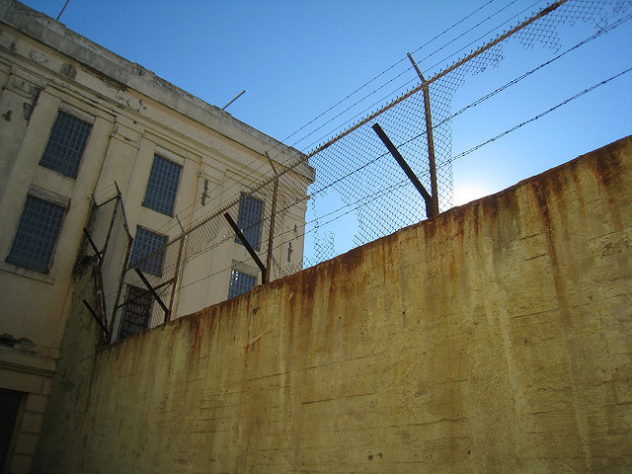
Egress
Doors
  Sliding
  Remote controlled
  50 lb force
Compartments
Enclosed areas
Staff actions
Sprinklers

